Slide 1
Session 1: Bootstrap from Zero to Intermediate
Gokkul Nath T S (EGOKKUL)

Slide 2
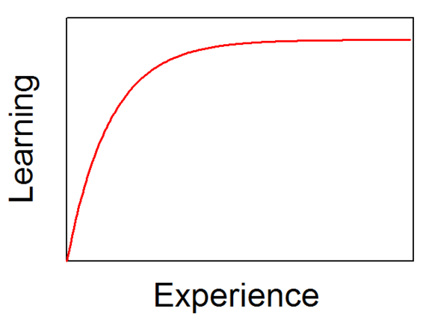
Note/Disclaimer
Only to be used as a learning material. Not for any commercial use.
These slides have been substantially sourced from Multiple Online platforms with some modifications made for easier understanding.
All rights belong to the Original Authors.
The Training Sessions are structured in such a way that it starts with very basics, progressively grows into complex concepts.
You may not follow the contents at some point. Take a break and Revisit from that point.

Slide 3
What to Expect from this Session?
Introduction to Python (General Purposes)
Understanding the Basic Syntaxes and constructs
Understanding Data types and its use cases
Loops, Classes and Functions
Expected Outcomes:
Able to Write Code/Programs (20 to 30 lines)
Able to Understand the Problem Statement/Situation and Tackle the problem
Identify Potential Use Cases to automate things with respect Telecom Industry
Note : The Training is planed to be more hands on experimentation rather than being theoretical.

Slide 4
agenda
Introduction of Python
Why Python?
Programming basics
Variables and print formatting
Strings
Lists, Tuples and sequences
Dictionary and sets
Conditions, operators and Type casting
Loops
Functions

Slide 5
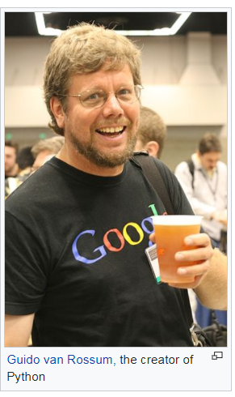
Introduction to Python
Python was first released in 1991.
Python is an interpreted high-level programming language for general-purpose programming.
Python has a design philosophy that emphasizes code readability, notably using significant whitespace.
Supports object oriented, imperative, functional and procedural programming paradigms.
CPython, commonly used reference implementation (Opensource) of Python and is managed by the non-profit Python Software Foundation.
Current Versions: 2.7.xx (EOL 2020)and 3.5+

Slide 6
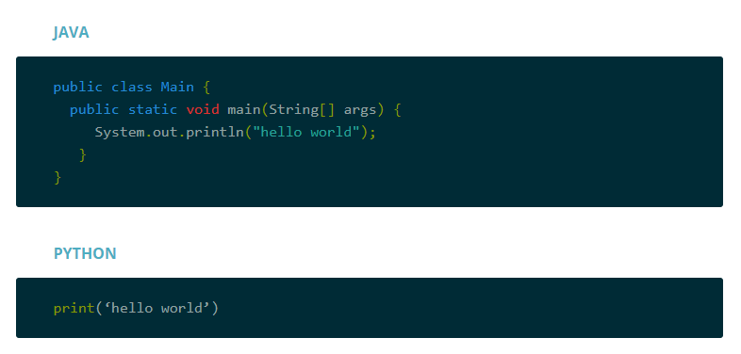
Why Python?
Python is easy to use, powerful, and versatile, making it a great choice for beginners and experts alike.
Python’s readability makes it a great first programming language — it allows you to think like a programmer and not waste time understanding the mysterious syntax that other programming languages can require.

Slide 7
Not Convinced yet ??
Very Flexible : As a dynamically typed language, Python is really flexible. This means there are no hard rules on how to build features, and you'll have more flexibility solving problems using different methods
In the 2018 Stack Overflow developer survey the data indicated that Python was the fastest growing major programming language and that there is a close alignment between the languages and tools that developers choose to learn and the usage in developers' professional work.
According to the TIOBE index, Python is the 4th most popular programming language out of 100. (based on number of lines of code that has been written.)
GitHut, a visualization of GitHub language popularity, pegs Python at #3 overall.
These rankings provide a rough measure for language popularity. They are not intended as a precise measurement tool to determine exactly how many developers are using a language. However, the aggregate view shows that Python remains a stable programming language with a growing ecosystem.
Source: https://www.fullstackpython.com/why-use-python.html

Slide 8
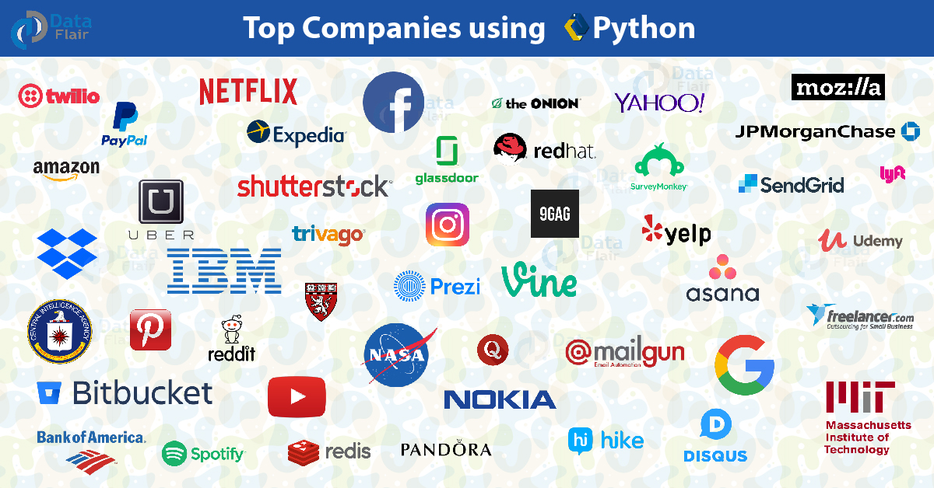
Source: https://data-flair.training/blogs/python-career-opportunities/

Slide 9
As of March 2019, the Python Package Index (PyPI), the official repository for third-party Python software, contains over 178,000 packages with a wide range of functionality, including:
Python Usage
Graphical user interfaces
Web frameworks
Multimedia
Databases
Networking
Test frameworks
Automation
Web scraping
Documentation
System administration
Scientific computing
Text processing
Image processing

Slide 10
Which Version of Python?
Python 2.x is legacy, Python 3.x is the present and future of the language
Python 3.0 was released in 2008. The final 2.x version 2.7 release came out in mid-2010, with a statement of extended support for this end-of-life release(2020). The 2.x branch will see no new major releases after that.
Depends on environment where the code is deployed and you don’t have control, that may require use of a specific version, rather than allowing you a free selection from the available versions.
Secondly, if you want to use a specific third party package or utility that doesn't yet have a released version that is compatible with Python 3, and porting that package is a non-trivial task, you may choose to use Python 2 in order to retain access to that package.
We will be using Python 3.6. (Differences between Python 2 and 3 are subtle and will be discussed when required)

Slide 11
Python Environment Setup

Slide 12
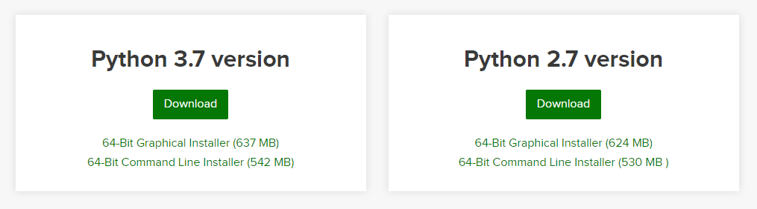
Installation of Python Anaconda[Jupyter]
Steps:
Navigate to Anaconda’s Download Webpage:
Link : https://www.anaconda.com/distribution/
Select the corresponding Operating System and then get Python 3 Version of installer
Execute the Installer in Admin mode.
Once Installation is Completed you should be able to see Jupyter Notebook.
It Should open a browser with Notebook layed out for Code Execution
Jupyter: Quick Overview

Slide 13
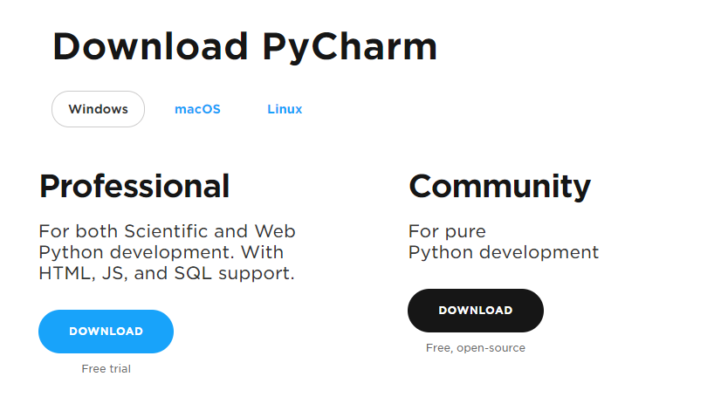
Installation of Python Pycharm IDE
Steps:
Navigate to Anaconda’s Download Webpage:
Link : https://www.jetbrains.com/pycharm/download/#section=windows
Download the Community Edition
Execute the Installer in Admin mode.
Once Installation is Completed you should be able to see Pycharm.

Slide 14
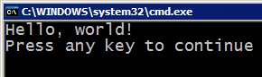
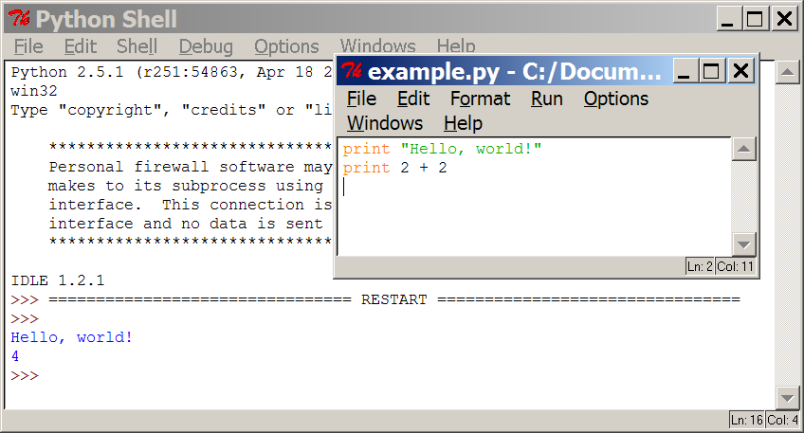
Programming basics
code or source code: The sequence of instructions in a program.
syntax: The set of legal structures and commands that can be used in a particular programming language.
output: The messages printed to the user by a program.
console: The text box onto which output is printed.
Some source code editors pop up the console as an external window, and others contain their own console window.

Slide 15




Compiling and interpreting
Many languages require you to compile (translate) your program into a form that the machine understands.
Python is instead directly interpreted into machine instructions.
compile
execute
source code
Hello.java
byte code
Hello.class
output
interpret
source code
Hello.py
output

Slide 16
Expressions
expression: A data value or set of operations to compute a value.
Examples: 1 + 4 * 3
42
Arithmetic operators we will use:
+ - * / addition, subtraction/negation, multiplication, division
% modulus, a.k.a. remainder
** exponentiation
precedence: Order in which operations are computed.
* / % ** have a higher precedence than + - 1 + 3 * 4 is 13
Parentheses can be used to force a certain order of evaluation. (1 + 3) * 4 is 16

Slide 17
Misc. Basics
Putting a hash bang (#!) on the first line of the file, followed by the path to the interpreter, and by changing the executable bit on the file, you can create a file that can run itself.
E.g. : #!/usr/bin/env python , To make File executable chmod +x hello .py
standard out: Black Screen/Monitor/Console output
standard in : raw_input() or input() function is used to get input from user. (Handles the entered data as string)
Seasoned programmers will keep an interpreter open during coding and use it as a scratch pad.
print function in Python 3 functions require parentheses,

Slide 18
Variables
State deals with a digital representation of a model.
Mutation deals with changing the state to a new or different state.
Variables are the building blocks of keeping track of state. (Similar to label or tag)
Creation of Variable :
We use =(equals) sign (assignment operator) to create variables
>>> status = "off"

Slide 19
Basic Data Types:
Strings :A string holds character information that can have any number of
characters (including 0 characters i.e “)
Strings are specified with single quotes, double quotes or triple quotes.
Triple quotes is used when handle strings of multiple lines.
escape the inner quotes by preceding them with a backslash \.
Integers and floats : An integer is a whole number. Whole numbers are numbers like 3, 0, or -10. A float represents real numbers. Real numbers have decimal places in them like 2.5, 0.0, or -5.0
Booleans : Booleans are a built-in type to represent a binary toggle between true and false. Booleans are frequently used to keep track of the status of a task, ie whether it is done or not

Slide 20
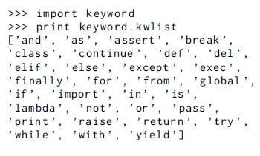
Naming variables :
Variables should not be a keyword
The Module Keyword has a kwlist attribute
The rules are simple—variables should:
be lowercase
use an underscore to separate words
not start with numbers
not override a built-in function
Tip:
Rules and conventions for naming in Python come from
a document named “PEP 8 – Style Guide for Python Code”.
PEP stands for Python Enhancement Proposal, which is a
community process for documenting a feature, enhancement
or best practice for Python.
Built-ins are functions, classes or variables that Python automatically preloads for you, so you get easy access to them. Unlike keywords, Python will let you use a built-in as a variable name without so much as a peep. However, you should refrain from doing this, it is a bad practice.

Slide 21



More about Objects:
Three important properties of objects:
Identity: Identity at its lowest level refers to the location in the computer’s memory of an object
Note : Id of an object is consistent across the lifetime of a program.
Two variables can refer to same object.

Slide 22

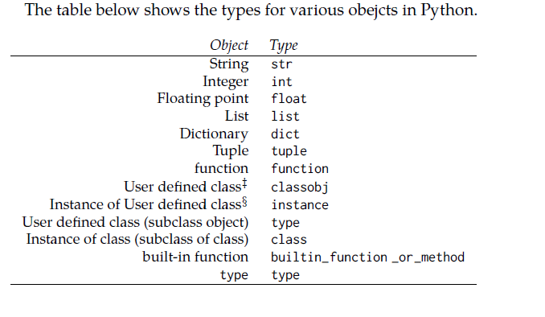
Type: Another property of an object is its type. Common types are strings, integers, floats, and Booleans.
The type of an object refers to the class of an object. A class defines the state of data an object holds, and the methods or actions that it can perform.

Slide 23
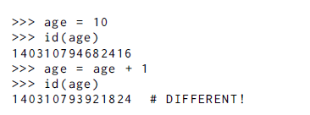
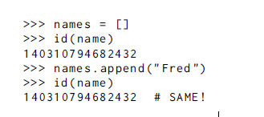
Mutability: Mutable objects can change their value in place, in other words you can alter their state, but their identity stays the same.
i.e when you alter an item if the id remains the same then it is mutable.
In Python, dictionaries and lists are mutable types. Strings, tuples, integers, and floats are immutable types.

Slide 24
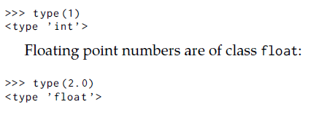
Manipulating numbers with Python
In Python everything is an object, including numbers. Integers are of class int or long:
# Math is what you would expect
1 + 1 # => 2
8 - 1 # => 7
10 * 2 # => 20
35 / 5 # => 7.0
# Result of integer division truncated down both for positive and negative.
5 // 3 # => 1
5.0 // 3.0 # => 1.0 # works on floats too
-5 // 3 # => -2
-5.0 // 3.0 # => -2.0
# The result of division is always a float
10.0 / 3 # => 3.3333333333333335
# Modulo operation
7 % 3 # => 1
# Exponentiation (x**y, x to the yth power)
2**3 # => 8
# Enforce precedence with parentheses
(1 + 3) * 2 # => 8
Order of operations: when you are performing math, we apply all the operations from left to right. You do multiplication and division before addition and subtraction. (Typical BODMAS Rule)

Slide 25
Assignment Operators
Operator
=
+=
-=
*=
/=
**=
//=
%=
Example
x = 5
x += 5
x -= 3
x *= 3
x /= 2
x **= 2
x //= 3
x %= 8
Value of x
5
10
7
21
10.5
110.25
36.0
4.0
Note : We don’t have ++, -- and turnery operators in Python

Slide 26
Math commands
Python has useful commands for performing calculations.
To use many of these commands, you must write the following at the top of your Python program:
from math import *
Command name | Description
abs(value) | absolute value
ceil(value) | rounds up
cos(value) | cosine, in radians
floor(value) | rounds down
log(value) | logarithm, base e
log10(value) | logarithm, base 10
max(value1, value2) | larger of two values
min(value1, value2) | smaller of two values
round(value) | nearest whole number
sin(value) | sine, in radians
sqrt(value) | square root
Constant | Description
e | 2.7182818...
pi | 3.1415926...

Slide 27
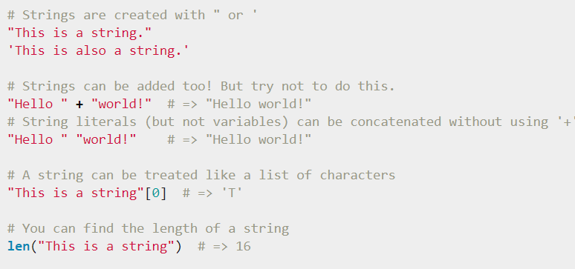
Strings

Slide 28
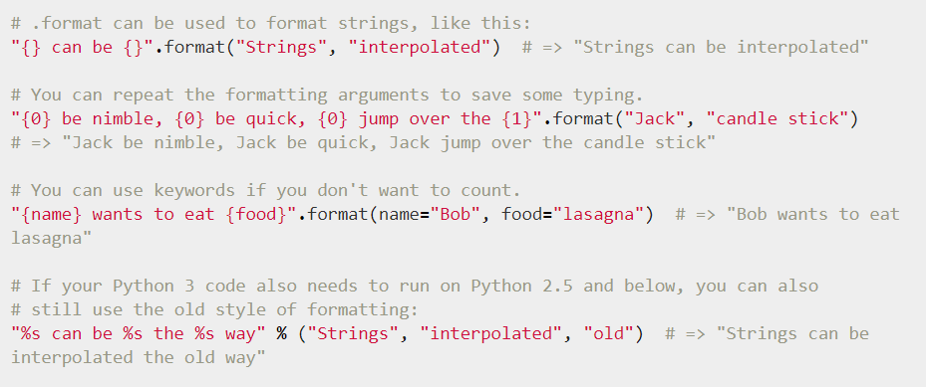
Note: if you want to include a single quote in a single quoted string you must escape the inner quotes by preceding them with a backslash \.

Slide 29
Commonly Used methods on Strings
Splitlines() : splits paragraph into list of lines.
capitalize() : Capitalizes first letter of string
count (): Counts how many times str occurs in string or in a substring of string if starting index beg and ending index end are given.
replace(old, new [, max]) : Replaces all occurrences of old in string with new or at most max occurrences if max given.
split(str="", num=string.count(str)): Splits string according to delimiter str (space if not provided) and returns list of substrings; split into at most num substrings if given.
lstrip(): Removes all leading whitespace in string.
rstrip(): Removes all trailing whitespace of string.
strip([chars): Return a copy of the string with the leading and trailing characters removed. The chars argument is a string specifying the set of characters to be removed. If omitted or None, the chars argument defaults to removing whitespace
swapcase() : Inverts case for all letters in string.

Slide 30
isalnum(): Returns true if string has at least 1 character and all characters are alphanumeric and false otherwise.
isalpha(): Returns true if string has at least 1 character and all characters are alphabetic and false otherwise.
isdigit() : Returns true if string contains only digits and false otherwise.
islower(): Returns true if string has at least 1 cased character and all cased characters are in lowercase and false otherwise.
istitle(): Returns true if string is properly “Title Cased" and false otherwise.
isupper(): Returns true only if all the characters are in uppercase and false otherwise.
isdecimal(): Returns true if a string contains only decimal characters and false otherwise.
find(sub[, start[, end]]) : Return the lowest index in the string where substring sub is found within the slice s[start:end]
Note: dir(obj) lists all the attributes of the object passed into it.

Slide 31
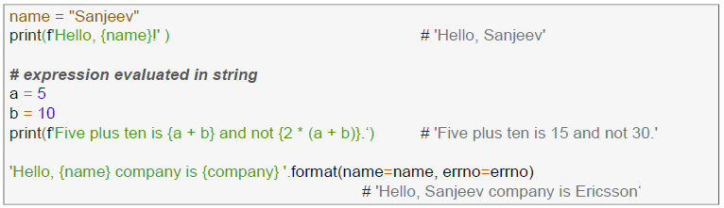
Stings Miscellaneous:
If you do not want to use an escape sequence, you can make a raw string, by preceding the string with an r. Raw strings are normally used in regular expressions, where the backslash can be common.
Triple quoted strings are also commonly used in docstrings.
%s, %d, and %x are replaced by their string, integer, and hex value respectively.
f’ strings are introduced in Python 3.6+. Example use case

Slide 32
Sequences
Sequence is an Python object in which elements can be access using sequence number / index
Slicing and indexing operations are features of sequence.
Indexing allows to access a particular item in the sequence directly
slicing operation allows to retrieve a part of the sequence.
Indexing:
Fetches components at offsets
Negative indexes count backward from the end (last item is at offset −1).
Slicing:
Extracts contiguous sections of a sequence, from i through j−1.
Slice boundaries i and j default to 0 and sequence length len(S)
Common sequences available in Python:
strings, lists, tuples, range / generator objects.

Slide 33
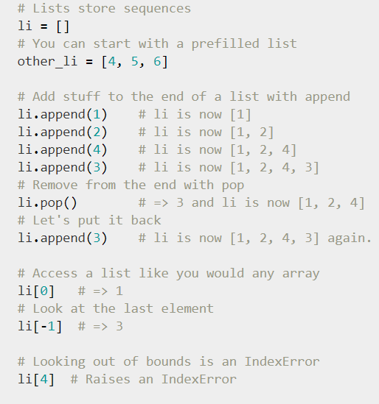
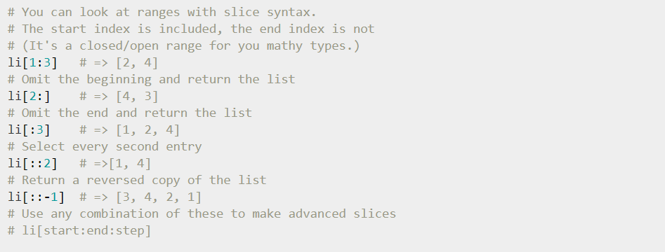
Sequences : List
List is a container of arbitrary Python objects which can be accessed using index

Slide 34
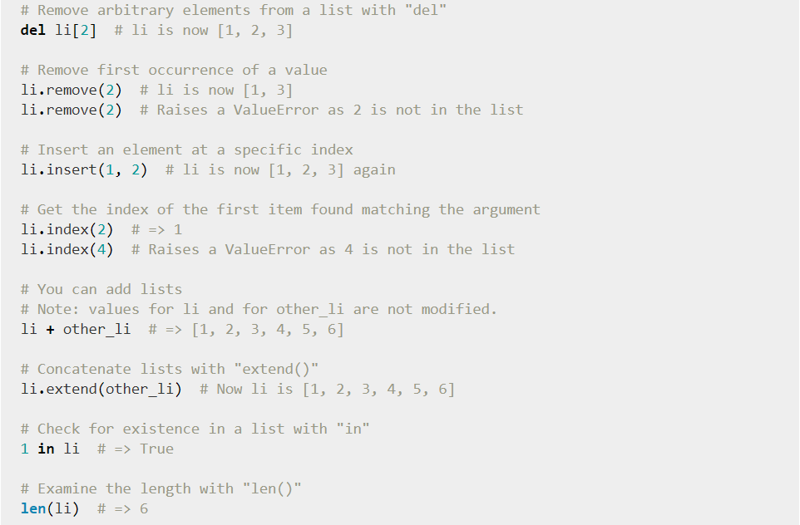
Sequences : List

Slide 35
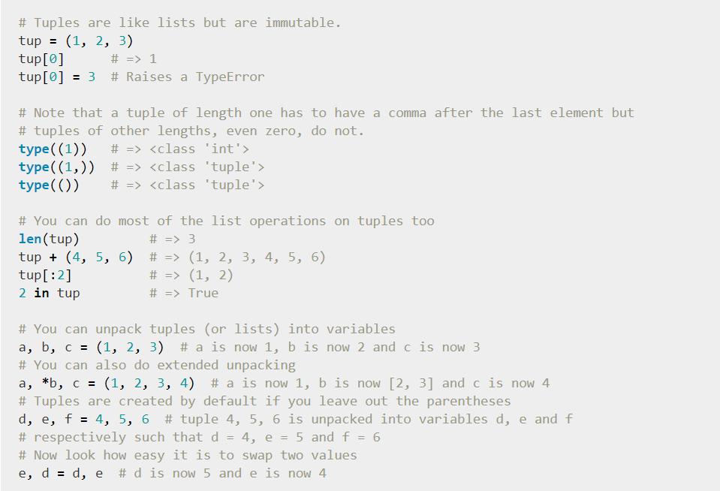
Sequences : Tuple
It’s an Immutable list or we can say that a tuple is a sequence of immutable python objects.

Slide 36
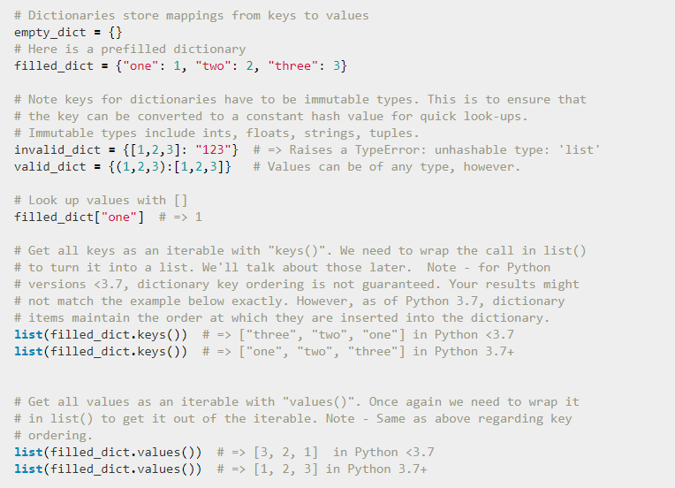
Dictionary

Slide 37
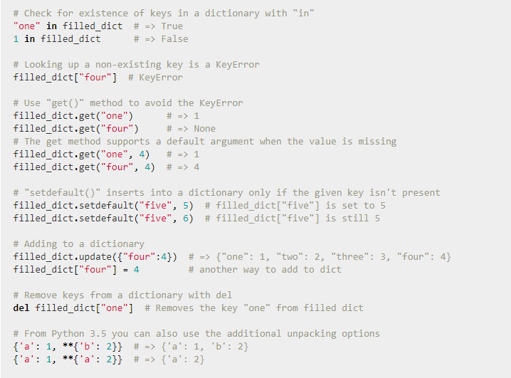

Slide 38
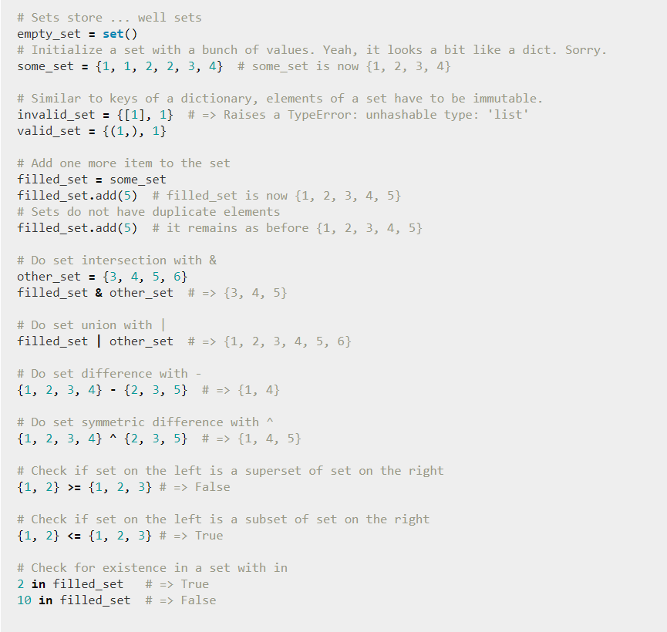
Sets

Slide 39
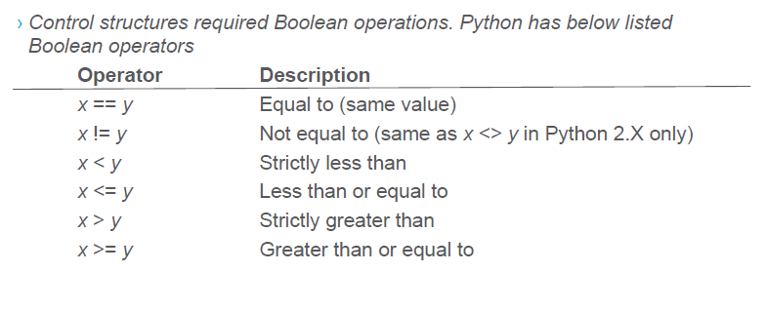
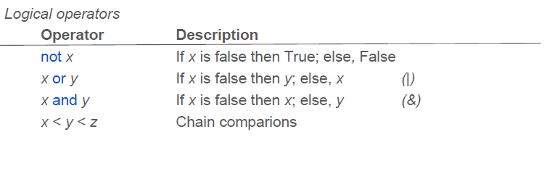
Conditionals

Slide 40
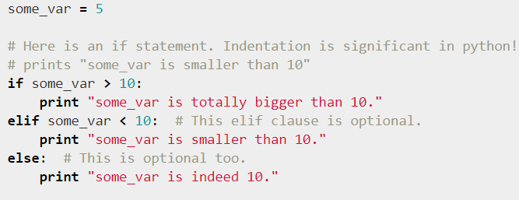
Conditional Constructs

Slide 41
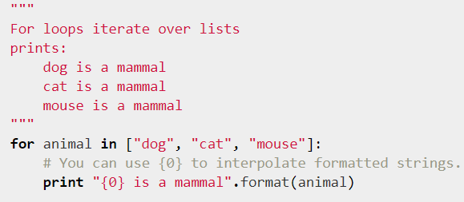
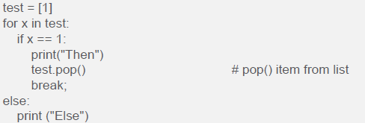
For statement with iterable
The else clause executes after the loop completes normally. This means that the
loop did not encounter a break statement

Slide 42
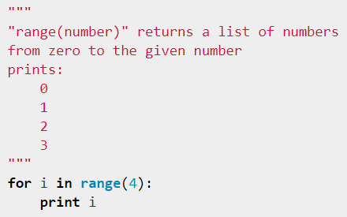
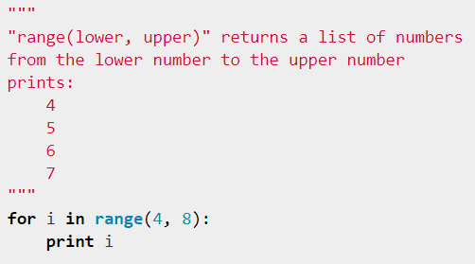
For statement with range function

Slide 43
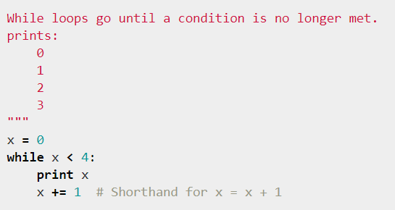
While control statement

